Slide 1
Parameterizing Collective Risk Models CAS Spring Meeting 2015

Slide 2
Overview
Collective Risk Model (CRM) for multiple lines of business with correlation.
Well-Trodden Ground:
Wang
Meyers and Collaborators
Mildenhall
Homer-Rosengarten
Many Others
Correlation: By common shock method as found in several of the references above – with a twist.
Along the way point out some underappreciated aspects of CRM.
Actually parameterizing simulation method consistent with the model.

Slide 3
Overview
Requirements:
Efficient as to runtime.
Efficient as to parameterization – relativity low number of parameters,
Simulate small and large losses – and reflect the appropriate dependency. Generate individual large losses and small losses in the aggregate.
Reflect correlation between lines/years.
Consistent with underlying CRM.

Slide 4
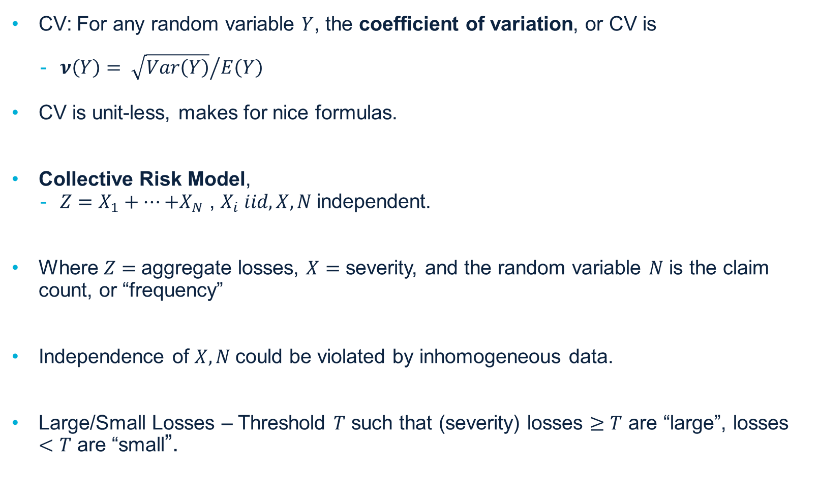
CRM – setup
CV: For any random variable $Y$, the coefficient of variation, or CV is
$ν\left(Y\right)= {\sqrt{Var\left(Y\right)}}/{E\left(Y\right)}$
CV is unit-less, makes for nice formulas.
Collective Risk Model,
$Z=X_{1}+…{+X}_{N}$ , $X_{i} iid, X, N$independent.
Where $Z=$aggregate losses, $X=$ severity, and the random variable $N$ is the claim count, or “frequency”
Independence of $X, N$could be violated by inhomogeneous data.
Large/Small Losses – Threshold $T$ such that (severity) losses $≥T$ are “large”, losses $<T$ are “small”.

Slide 5
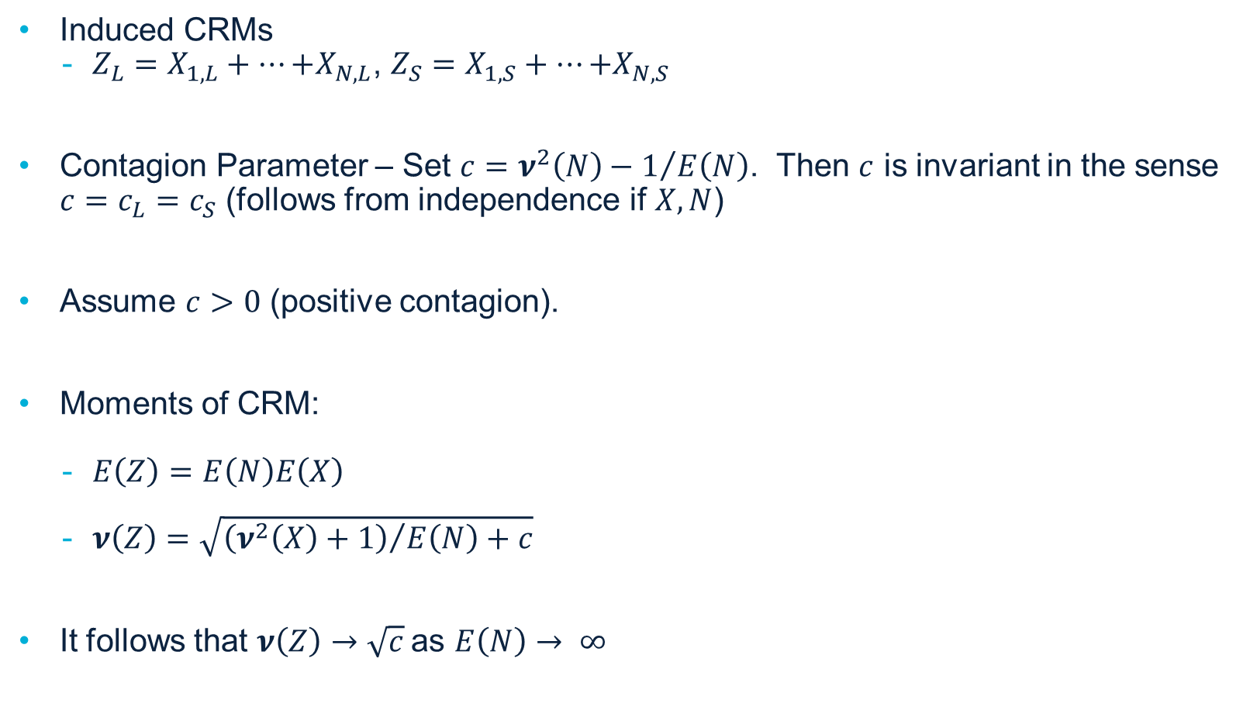
CRM – Contagion Factor, Moments
Induced CRMs
$Z_{L}=X_{1,L}+…{+X}_{N,L}$, $Z_{S}=X_{1,S}+…{+X}_{N,S}$
Contagion Parameter – Set $c=ν^{2}\left(N\right)−1/{E\left(N\right)}$. Then $c$ is invariant in the sense $c=c_{L}=c_{S}$ (follows from independence if $X,N$)
Assume $c>0$ (positive contagion).
Moments of CRM:
$E\left(Z\right)=E\left(N\right)E\left(X\right)$
$ν\left(Z\right)=\sqrt{{\left(ν^{2}\left(X\right)+1\right)}/{E\left(N\right)}+c}$
It follows that $ν\left(Z\right)→\sqrt{c}$as $E\left(N\right)→ ∞$

Slide 6

CRM – Large, Small, Total Losses
Correlation:
$ρ\left(Z_{S},Z_{L}\right)=c/{\left(ν\left(Z_{S}\right)ν\left(Z_{L}\right)\right)}$
(common shock based on identical mixing distributions)
Total Variation:
$E^{2}\left(Z\right)\left(ν^{2}\left(Z\right)−c\right)=E^{2}\left(Z_{L}\right)\left(ν^{2}\left(Z_{L}\right)−c\right)+E^{2}\left(Z_{S}\right)\left(ν^{2}\left(Z_{S}\right)−c\right)$.

Slide 7
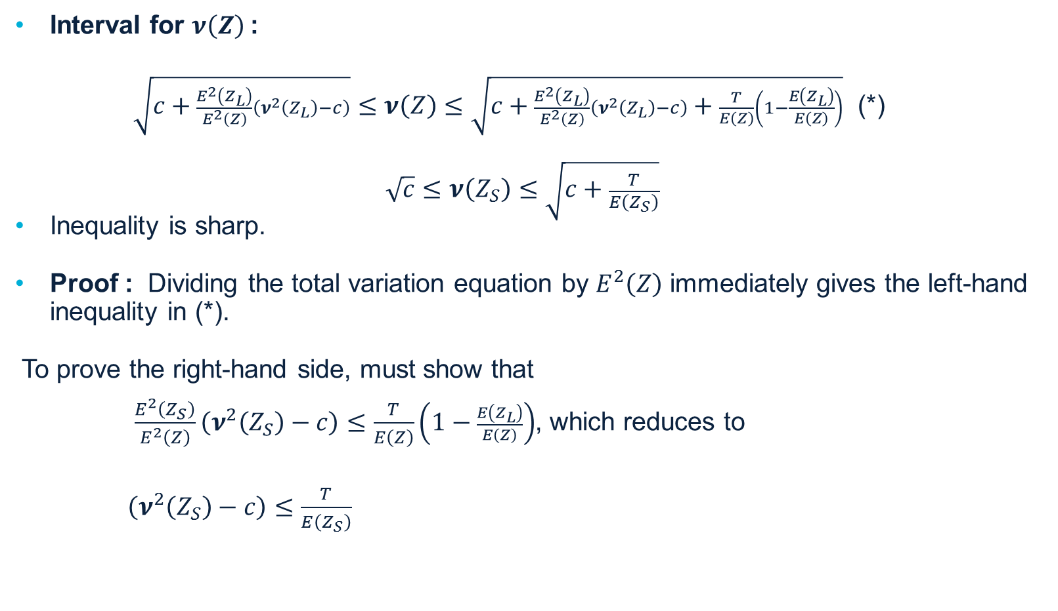
CV Interval
Interval for $ν\left(Z\right)$:
$\sqrt{c+\frac{E^{2}\left(Z_{L}\right)}{E^{2}\left(Z\right)}\left(ν^{2}\left(Z_{L}\right)−c\right)}≤ν\left(Z\right)≤\sqrt{c+\frac{E^{2}\left(Z_{L}\right)}{E^{2}\left(Z\right)}\left(ν^{2}\left(Z_{L}\right)−c\right)+\frac{T}{E\left(Z\right)}\left(1−\frac{E\left(Z_{L}\right)}{E\left(Z\right)}\right)}$ (*)
$$\sqrt{c}≤ν\left(Z_{S}\right)≤\sqrt{c+\frac{T}{E\left(Z_{S}\right)}}$$
Inequality is sharp.
Proof : Dividing the total variation equation by $E^{2}\left(Z\right)$ immediately gives the left-hand inequality in (*).
To prove the right-hand side, must show that
$\frac{E^{2}\left(Z_{S}\right)}{E^{2}\left(Z\right)}\left(ν^{2}\left(Z_{S}\right)−c\right)≤\frac{T}{E\left(Z\right)}\left(1−\frac{E\left(Z_{L}\right)}{E\left(Z\right)}\right)$, which reduces to
$\left(ν^{2}\left(Z_{S}\right)−c\right)≤\frac{T}{E\left(Z_{S}\right)}$

Slide 8
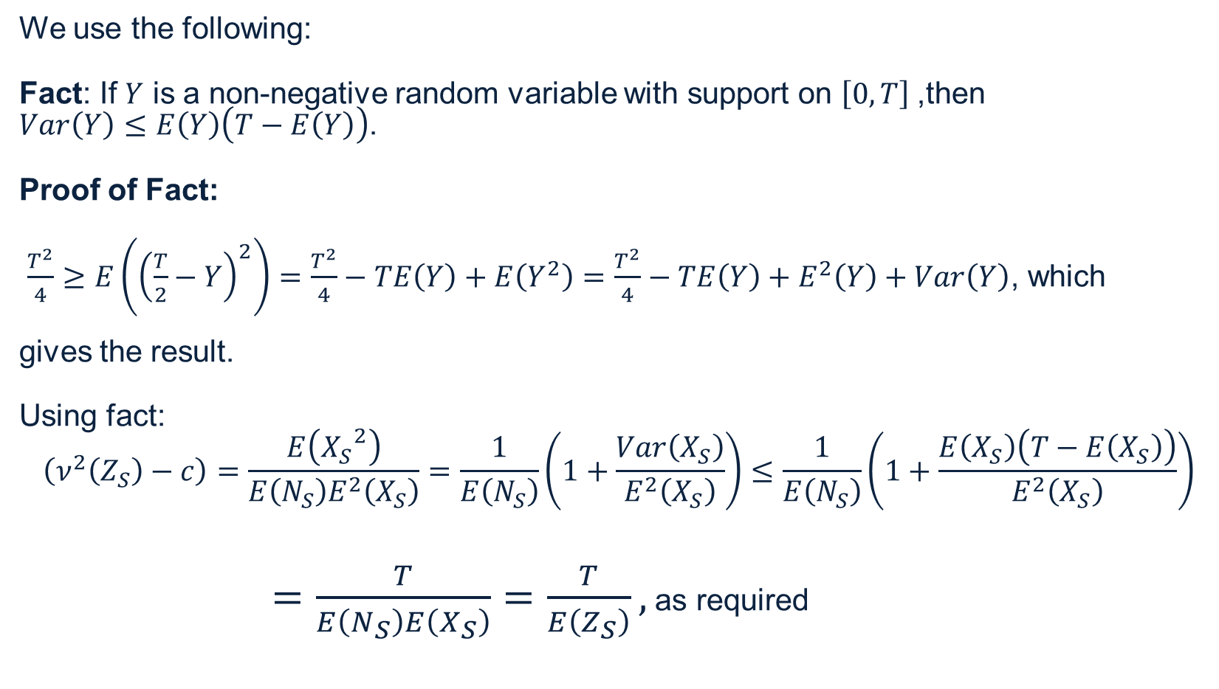
CV Interval
We use the following:
Fact: If $Y$ is a non-negative random variable with support on $\left[0,T\right]$,then
$Var\left(Y\right)≤E\left(Y\right)\left(T−E\left(Y\right)\right)$.
Proof of Fact:
$\frac{T^{2}}{4}≥E\left({\left(\frac{T}{2}−Y\right)}^{2}\right)=$ $\frac{T^{2}}{4}−TE\left(Y\right)+E\left(Y^{2}\right)=\frac{T^{2}}{4}−TE\left(Y\right)+E^{2}\left(Y\right)+Var\left(Y\right)$, which
gives the result.
Using fact:
$$\left(ν^{2}\left(Z_{S}\right)−c\right)=\frac{E\left({X_{S}}^{2}\right)}{E\left(N_{S}\right)E^{2}\left(X_{S}\right)}=\frac{1}{E\left(N_{S}\right)}\left(1+\frac{Var\left(X_{S}\right)}{E^{2}\left(X_{S}\right)}\right)≤\frac{1}{E\left(N_{S}\right)}\left(1+\frac{E\left(X_{S}\right)\left(T−E\left(X_{S}\right)\right)}{E^{2}\left(X_{S}\right)}\right)$$
$=\frac{T}{E\left(N_{S}\right)E\left(X_{S}\right)}=\frac{T}{E\left(Z_{S}\right)},$ as required

Slide 9

CV Interval
For sharpness note that if we hold $E\left(Z_{S}\right)$ fixed while letting $E\left(N_{S}\right)→∞$, then $ν^{2}\left(Z_{S}\right)→c$,
so that $ν\left(Z\right)→\sqrt{c+\frac{E^{2}\left(Z_{L}\right)}{E^{2}\left(Z\right)}\left(ν^{2}\left(Z_{L}\right)−c\right)}$, which is the left-hand side of (*). Furthermore if we
take $X_{S}$ to be a 2-point distribution with masses at $X_{S}=0$ and ${ X}_{S}=T$ (with probability
$p=\frac{E\left(Z_{S}\right)}{E\left(N_{S}\right)T}$), then equality holds for the right-hand side of (*).

Slide 10
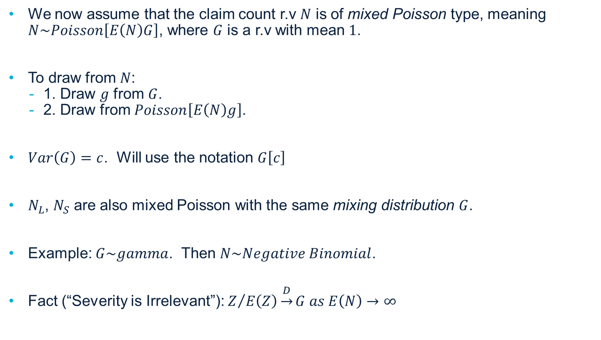
Mixed Poisson CRM
We now assume that the claim count r.v $N$ is of mixed Poisson type, meaning $N\sim Poisson\left[E\left(N\right)G\right]$, where $G$ is a r.v with mean $1$.
To draw from $N$:
1. Draw $g$ from $G$.
2. Draw from $Poisson\left[E\left(N\right)g\right]$.
$Var\left(G\right)=c$. Will use the notation $G\left[c\right]$
$N_{L}$, $N_{S}$ are also mixed Poisson with the same mixing distribution $G$.
Example: $G\sim gamma$. Then $N\sim Negative Binomial$.
Fact (“Severity is Irrelevant”): $Z/{E\left(Z\right)\underset{→}{D}}G as E\left(N\right)→∞$

Slide 11
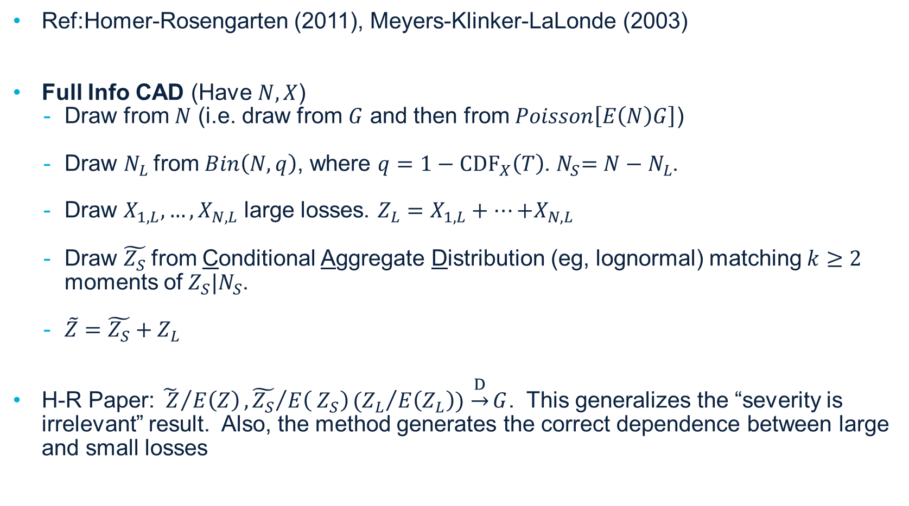
Simulation Method - CAD Algorithm with Frequency, “Severity” and Serial Common Shock
Ref:Homer-Rosengarten (2011), Meyers-Klinker-LaLonde (2003)
Full Info CAD (Have $N,X$)
Draw from $N$ (i.e. draw from $G$ and then from $Poisson\left[E\left(N\right)G\right]$)
Draw $N_{L}$from $Bin\left(N,q\right)$, where $q=1−{CDF}_{X}\left(T\right)$.${ N}_{S}=N−N_{L}$.
Draw $X_{1,L},…,X_{N,L}$ large losses. $Z_{L}=X_{1,L}+…{+X}_{N,L}$
Draw $\tilde{Z_{S}}$from Conditional Aggregate Distribution (eg, lognormal) matching$k≥2$ moments of${ Z}_{S}|N_{S}$.
$\tilde{Z}=\tilde{Z_{S}}+Z_{L}$
H-R Paper: ${\tilde{ Z}}/{E\left(Z\right)}, {\tilde{Z_{S}}}/{E\left({ Z}_{S}\right)}({Z_{L}}/{E\left(Z_{L}\right)})$ $\underset{→}{D}G$. This generalizes the “severity is irrelevant” result. Also, the method generates the correct dependence between large and small losses

Slide 12
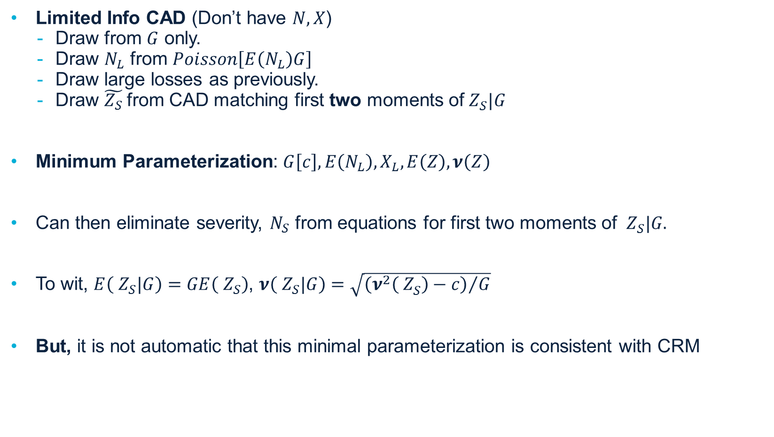
Simulation Method
Limited Info CAD (Don’t have $N, X$)
Draw from $G$ only.
Draw $N_{L}$ from $Poisson\left[E\left(N_{L}\right)G\right]$
Draw large losses as previously.
Draw $\tilde{Z_{S}}$from CAD matching first two moments of${ Z}_{S}^{}|G$
Minimum Parameterization: $G\left[c\right], E\left(N_{L}\right), X_{L}, E\left(Z\right), ν\left(Z\right)$
Can then eliminate severity, $N_{S}$ from equations for first two moments of ${ Z}_{S}^{}|G.$
To wit, $E\left({ Z}_{S}^{}|G\right)=GE\left({ Z}_{S}^{}\right)$, $ν\left({ Z}_{S}^{}|G\right)=\sqrt{{\left(ν^{2}\left({ Z}_{S}^{}\right)−c\right)}/G}$
But, it is not automatic that this minimal parameterization is consistent with CRM

Slide 13

Simulation Method
To address, suppose we have all the minimal parameters except $ν\left(Z\right)$. We can then evaluate the lhs and rhs of inequality (*)
$$\sqrt{c+\frac{E^{2}\left(Z_{L}\right)}{E^{2}\left(Z\right)}\left(ν^{2}\left(Z_{L}\right)−c\right)}≤ν\left(Z\right)≤\sqrt{c+\frac{E^{2}\left(Z_{L}\right)}{E^{2}\left(Z\right)}\left(ν^{2}\left(Z_{L}\right)−c\right)+\frac{T}{E\left(Z\right)}\left(1−\frac{E\left(Z_{L}\right)}{E\left(Z\right)}\right)}$$
Any choice for $ν\left(Z\right)$ within this interval is a) possible and b) consistent with MP CRM.

Slide 14
Beginning of Example – R² Ins. Co.
Loss Parameters
Non-Cat
LoB | Premium | E(Z) | Loss Ratio | ν(Z) | T | c | E(N_{L}) | E(Z_{L}) | X_{L} | ν(Z_{L}) | E(Z_{S}) | ν(Z_{S})
GL | 110,000,000 | 65,000,000 | 59.10% | 0.2000 | 1,000,000 | 0.03 | 3.500 | 5,457,138 | Empirical | 0.7349 | 59,542,862 | 0.194
WC | 90,000,000 | 45,000,000 | 50.00% | 0.2200 | 1,000,000 | 0.02 | 3.000 | 6,568,231 | Empirical | 0.7604 | 38,431,769 | 0.2065
CAL | 40,000,000 | 22,000,000 | 55.00% | 0.2750 | 1,000,000 | 0.04 | 0.250 | 512,500 | Empirical | 3.2929 | 21,487,500 | 0.2668
Umb | 9,000,000 | 6,500,000 | 72.20% | 0.5200 | 1,000,000 | 0.02 | 3.000 | 4,248,825 | Empirical | 0.7444 | 2,251,175 | 0.4525
PropNon-Cat | 300,000,000 | 175,000,000 | 58.30% | 0.1600 | 1,000,000 | 0.02 | 14.000 | 30,534,169 | Empirical | 0.3734 | 144,465,831 | 0.1513
Total Non-Cat | 549,000,000 | 313,500,000 | 57.10% | 0.1139 |  |  | 23.750 | 47,320,864 |  | 0.2877 | 266,179,136 | 0.1096
Cat
SmallCat | 549,000,000 | 40,000,000 | 7.30% | 0.4300 | 2,000,000 | 0.16 | 10.000 | 4,000,000 | Lognormal | 0.43 | - | -
MajorCat (Net) | 549,000,000 | 25,000,000 | 4.60% | 1.9000 | Inf | 1 | - | - | N\A | - | 25,000,000 | 1.9
Total Inc Cat | 549,000,000 | 378,500,000 | 68.94% | 0.1685 |  |  | 33.750 | 51,320,864 |  | 0.2847 | 291,179,136 | 0.195

Slide 15
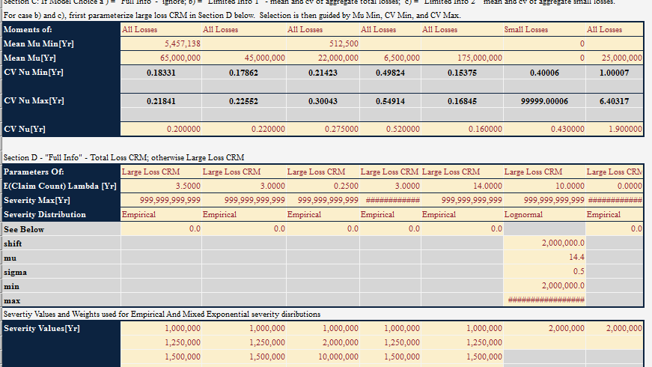
R² Ins Co. – Mean, CV Parameters

Slide 16
Common Shock Correlation
Correlate LoBs modeled with MP CRM/CAD method.
LoBs are organized into covariance groups. Only Lobs within the same covariance group co-vary with one another.
Frequency, “severity”, and serial common shock.

Slide 17
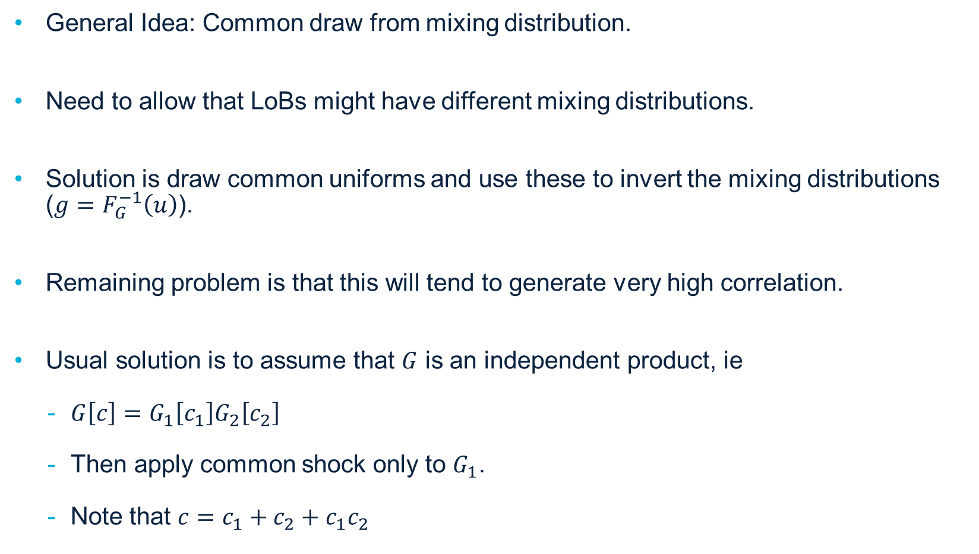
Frequency Common Shock
General Idea: Common draw from mixing distribution.
Need to allow that LoBs might have different mixing distributions.
Solution is draw common uniforms and use these to invert the mixing distributions ($g=F_{G}^{−1}\left(u\right)$).
Remaining problem is that this will tend to generate very high correlation.
Usual solution is to assume that $G$ is an independent product, ie
$G\left[c\right]=G_{1}\left[c_{1}\right]G_{2}\left[c_{2}\right]$
Then apply common shock only to $G_{1}$.
Note that $c=c_{1}+c_{2}+c_{1}c_{2}$

Slide 18
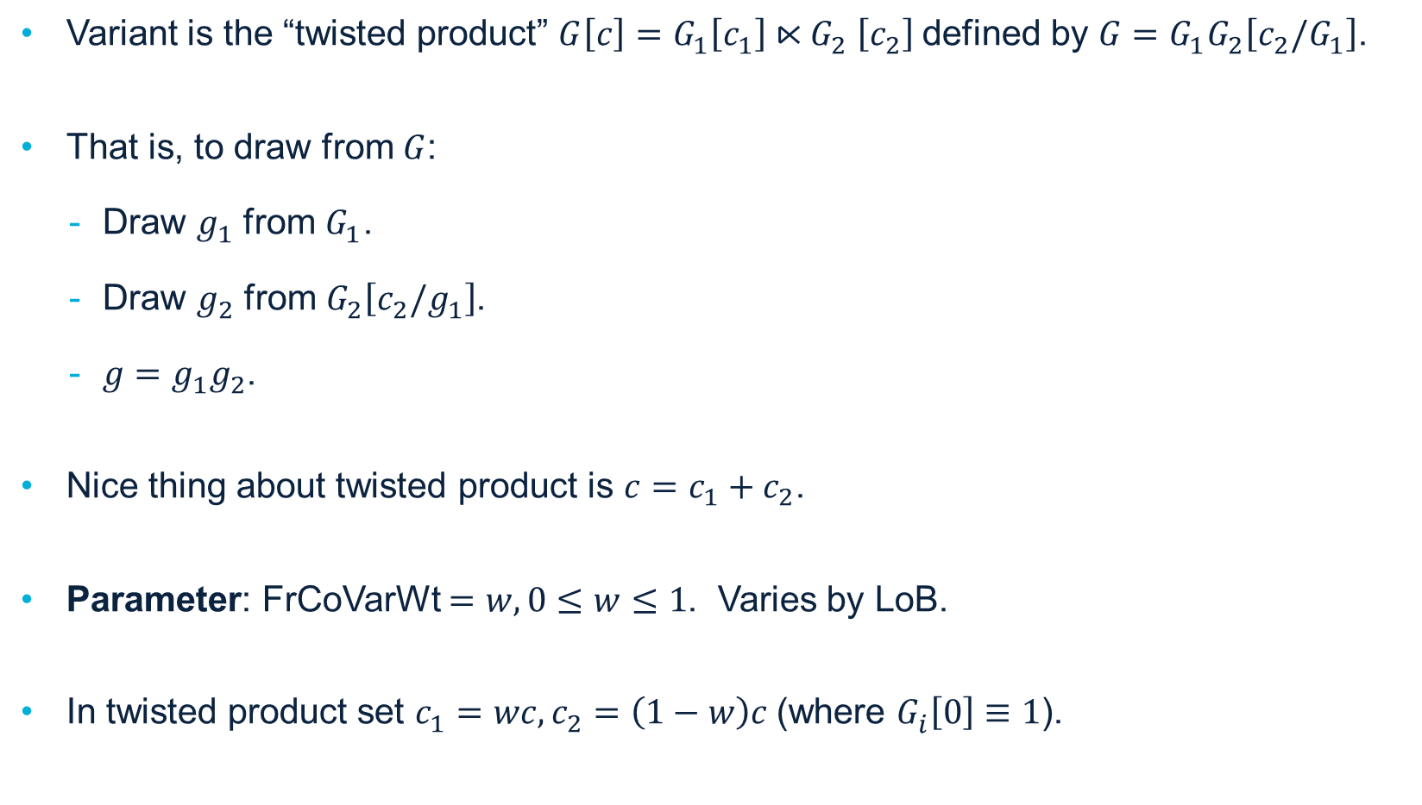
Frequency Common Shock
Variant is the “twisted product” $G\left[c\right]=G_{1}^{}\left[c_{1}^{}\right]{⋉G}_{2}^{}\left[c_{2}^{}\right]$defined by $G=G_{1}^{}G_{2}^{}\left[c_{2}^{}/G_{1}^{}\right]$.
That is, to draw from $G$:
Draw $g_{1}^{}$ from $G_{1}^{}$.
Draw $g_{2}^{}$ from $G_{2}^{}\left[c_{2}^{}/g_{1}^{}\right]$.
$g=g_{1}^{}g_{2}^{}$.
Nice thing about twisted product is $c=c_{1}+c_{2}$.
Parameter: FrCoVarWt $=w, 0≤w≤1$. Varies by LoB.
In twisted product set $c_{1}^{}=wc,c_{2}^{}=\left(1−w\right)c$(where $G_{i}^{}\left[0\right]≡1$).

Slide 19
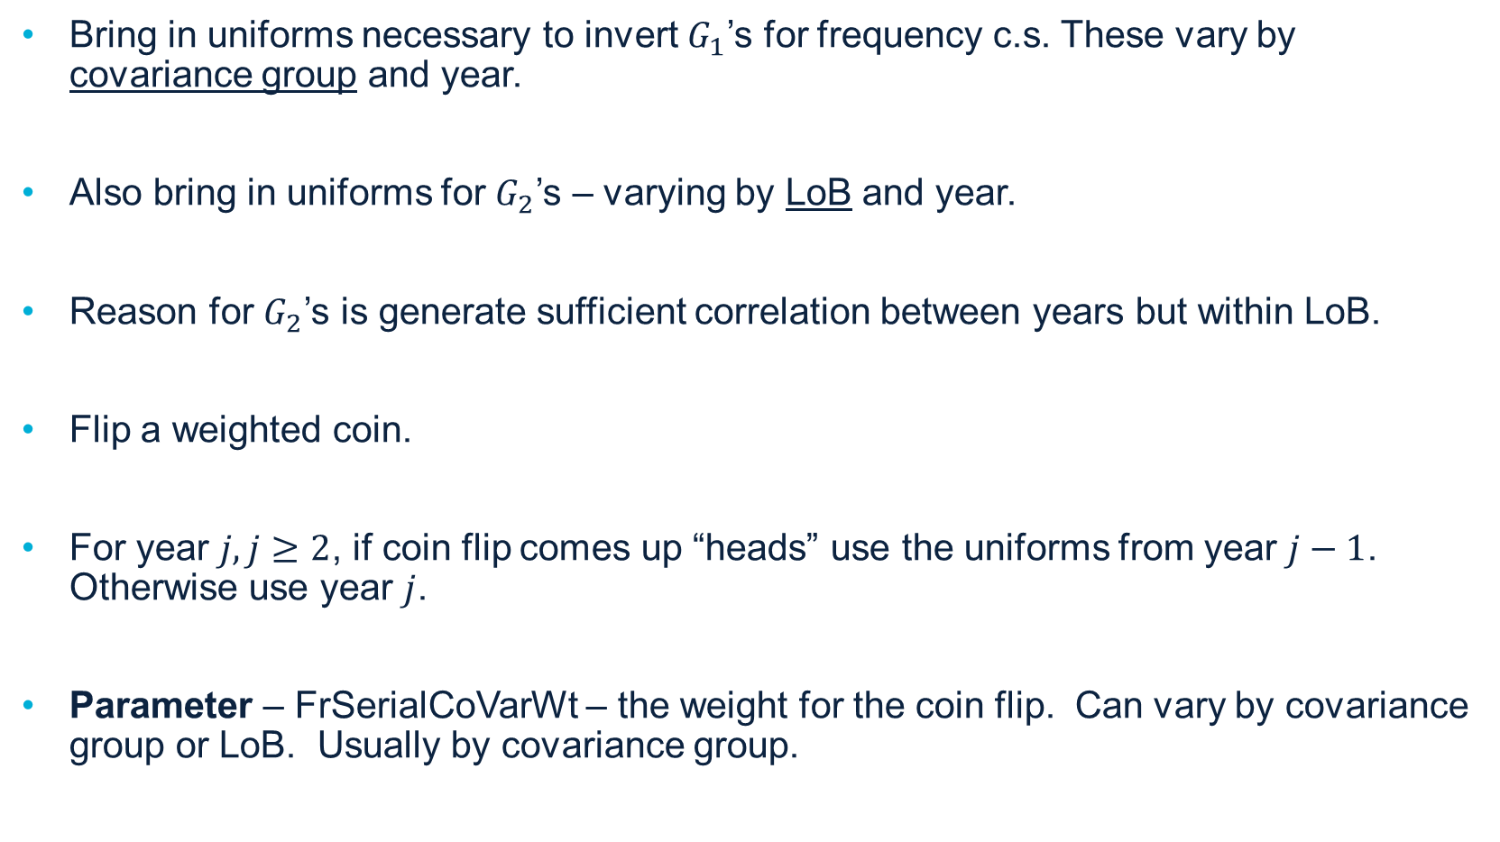
Serial Common Shock
Bring in uniforms necessary to invert $G_{1}$’s for frequency c.s. These vary by covariance group and year.
Also bring in uniforms for $G_{2}$’s – varying by LoB and year.
Reason for $G_{2}$’s is generate sufficient correlation between years but within LoB.
Flip a weighted coin.
For year $j, j≥2$, if coin flip comes up “heads” use the uniforms from year $j−1$. Otherwise use year $j$.
Parameter – FrSerialCoVarWt – the weight for the coin flip. Can vary by covariance group or LoB. Usually by covariance group.

Slide 20

Serial Common Shock
Summary
$G_{1}$correlates non-identical LoBs, both within-year and serially.
$G_{2}$ - serial correlation for identical LoBs.
Serial correlation decays by FrSerialCoVarWt.

Slide 21
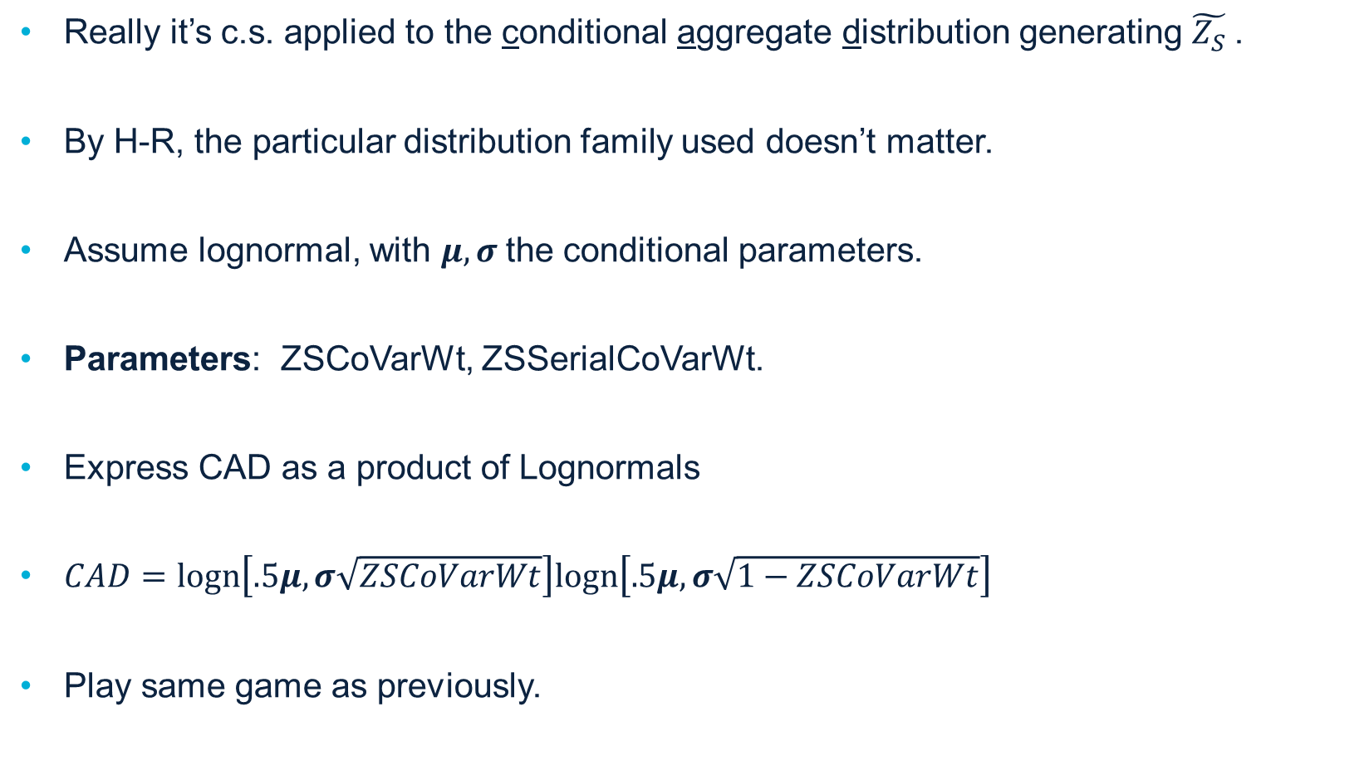
Serial Common Shock
Really it’s c.s. applied to the conditional aggregate distribution generating $\tilde{Z_{S}}$.
By H-R, the particular distribution family used doesn’t matter.
Assume lognormal, with $μ, σ$the conditional parameters.
Parameters: ZSCoVarWt, ZSSerialCoVarWt.
Express CAD as a product of Lognormals
$CAD=logn\left[.5μ,σ\sqrt{ZSCoVarWt}\right]logn\left[.5μ,σ\sqrt{1−ZSCoVarWt}\right]$
Play same game as previously.

Slide 22
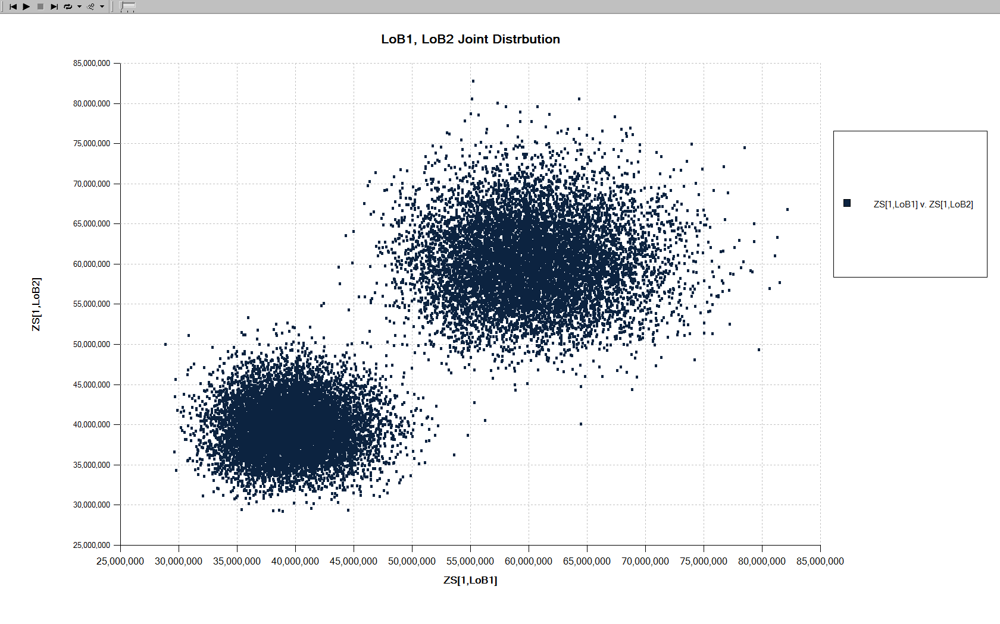
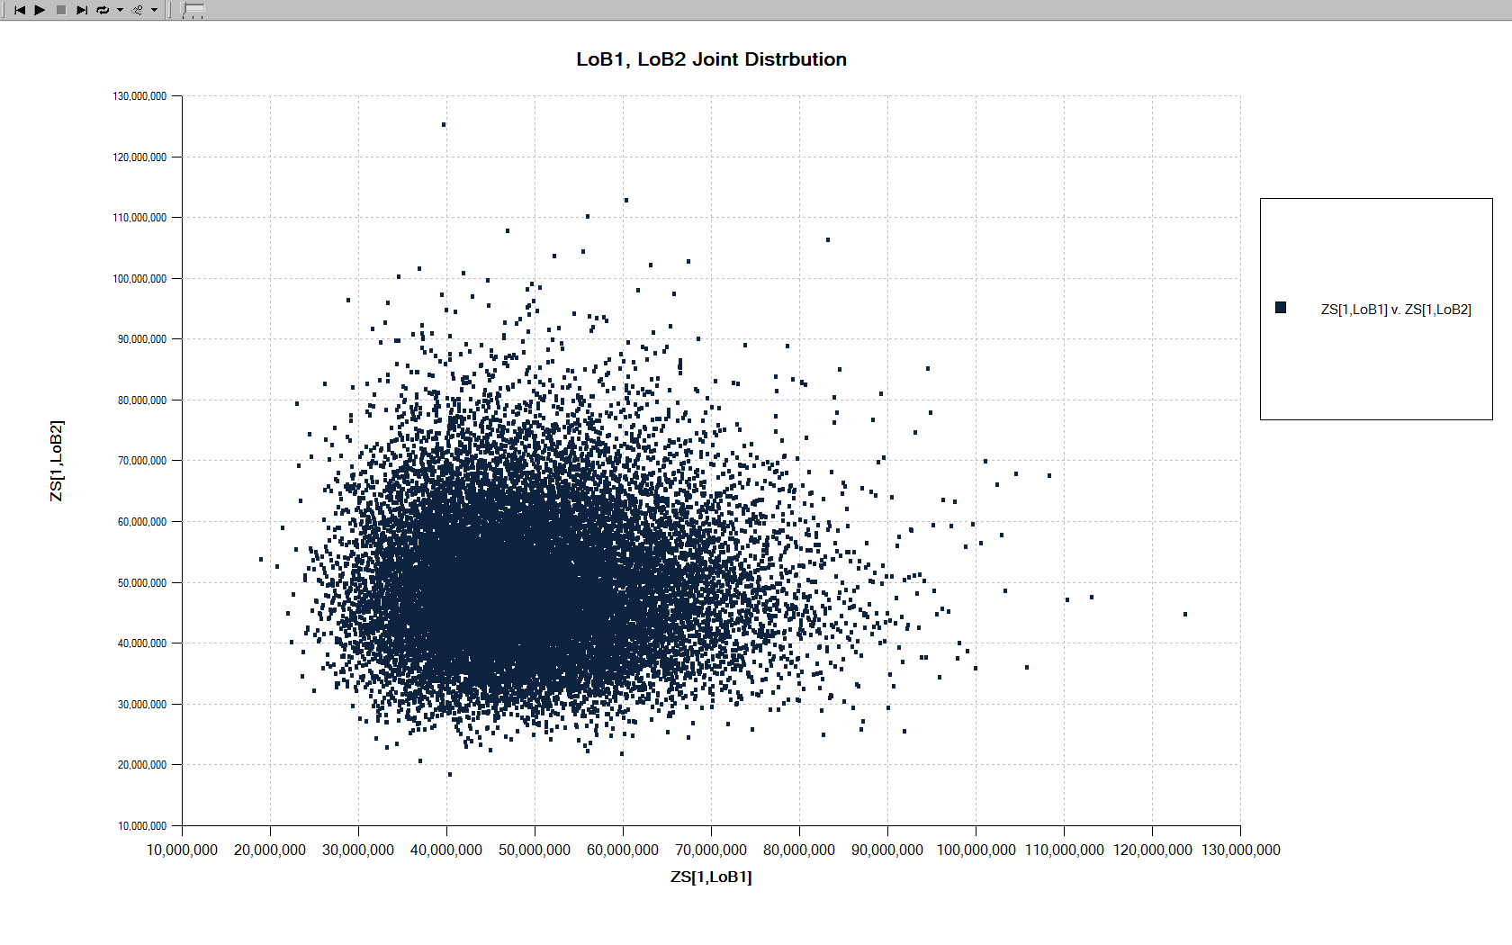

Why do we need ZSCoVarWt?
Example: Identical LoBs LoB1, LoB2
$FrCoVarWt=.85$, $ZSCoVarWt=0$, $G_{1}=1±\sqrt{c}$, with probabiltiy $.5$.
$c=O\left(ν^{2}\right)$ - High Correlation $c=0 \left(ν^{2}≫c\right)$ - No Correlation

Slide 23
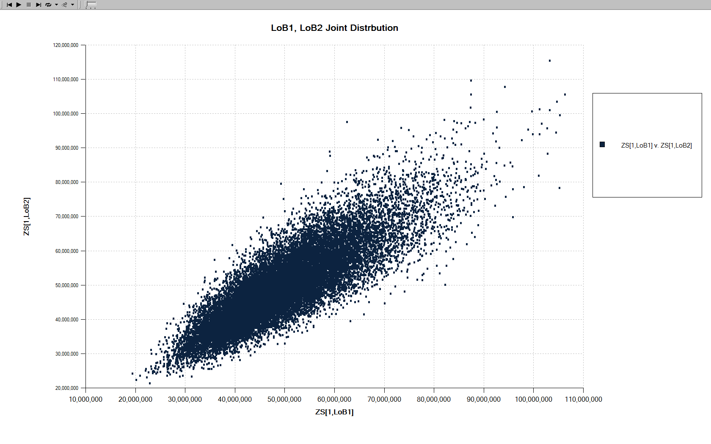

Why ZSCoVarWt?
$FrCoVarWt=0$, $ZSCoVarWt=.85$, $c=0$

Slide 24
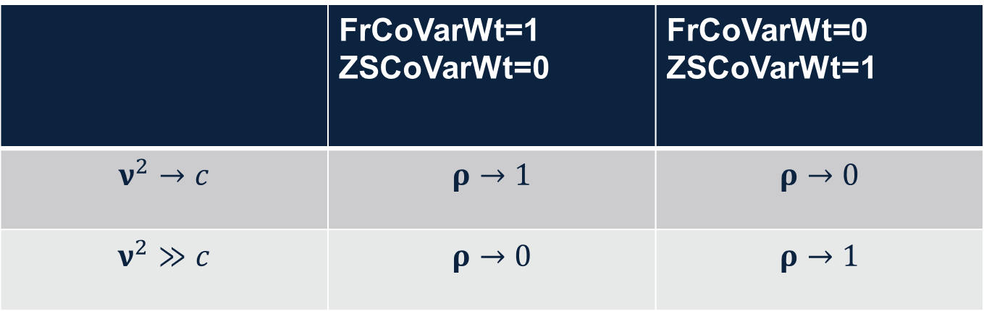
Why ZSCoVarWt?
For Identical LoBs:
 | FrCoVarWt=1 ZSCoVarWt=0 | FrCoVarWt=0 ZSCoVarWt=1
$$ν^{2}→c$$ | $$ρ→1$$ | $$ρ→0$$
$$ν^{2}≫c$$ | $$ρ→0$$ | $$ρ→1$$

Slide 25

More Tricks
Can increase skewness by adding shift to mixing distributions.
Shifted lognormal: $G=s+Logn\left[ln\left(\frac{{\left(1−s\right)}^{2}}{\sqrt{c+{\left(1−s\right)}^{2}}}\right),\sqrt{ln\left(1+\frac{c}{{\left(1−s\right)}^{2}}\right)}\right]$
Skewness $=\frac{\sqrt{c}}{\left(1−s\right)}\left(3+\frac{c}{{\left(1−s\right)}^{2}}\right)$
Can use discrete mixing distribution to create a mass at $0,$ for example.

Slide 26
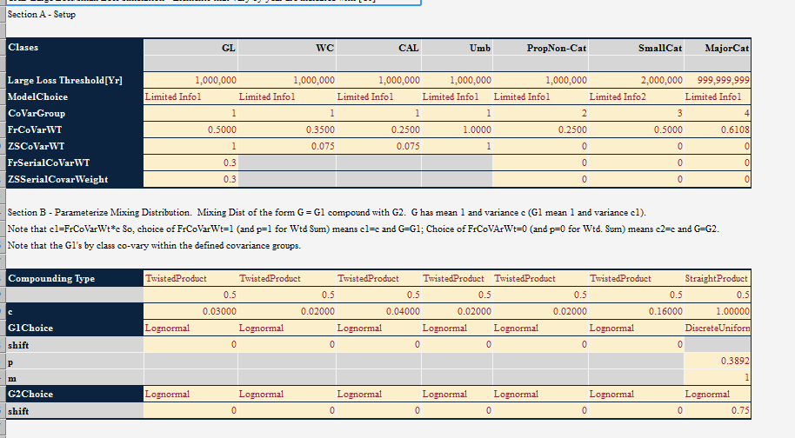
R² Ins. Co. – Correlation Parameters, Mixing Distributions

Slide 27
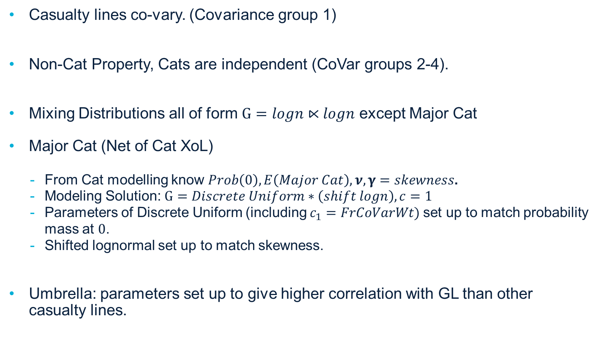
R² Ins Co. – Correlation Parameters, Mixing Distributions
Casualty lines co-vary. (Covariance group 1)
Non-Cat Property, Cats are independent (CoVar groups 2-4).
Mixing Distributions all of form $G=logn⋉logn$ except Major Cat
Major Cat (Net of Cat XoL)
From Cat modelling know $Prob\left(0\right), E\left(Major Cat\right), ν,γ=skewness$.
Modeling Solution: $G=Discrete Uniform∗\left(shift logn\right), c=1$
Parameters of Discrete Uniform (including $c_{1}=FrCoVarWt)$set up to match probability mass at $0$.
Shifted lognormal set up to match skewness.
Umbrella: parameters set up to give higher correlation with GL than other casualty lines.

Slide 28
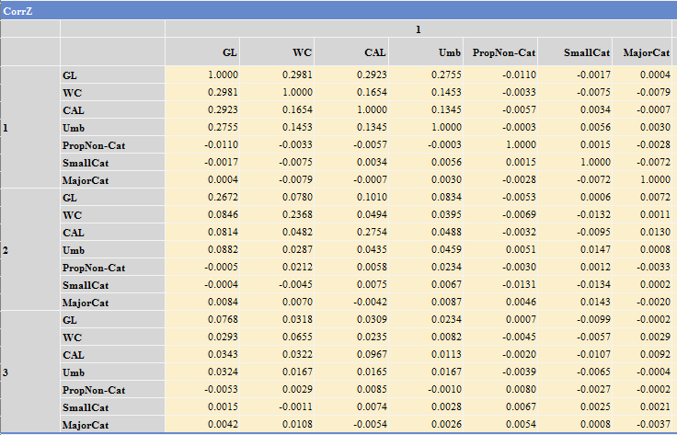
Correlation Matrix

Slide 29
Reinsurance Cover for R² Insurance Co.
Casualty lines co-vary. (Covariance group 1)
Non-Cat Property, Cats are independent (CoVar groups 2-4).
Mixing Distributions all of form $G=logn⋉logn$ except Major Cat
Major Cat (Net of Cat XoL)
From Cat modelling know $Prob\left(0\right), E\left(Major Cat\right), ν,γ=skewness$.
Modeling Solution: $G=Discrete Uniform∗\left(shift logn\right), c=1$
Parameters of Discrete Uniform (including $c_{1}=FrCoVarWt)$set up to match probability mass at $0$.
Shifted lognormal set up to match skewness.
Umbrella: parameters set up to give higher correlation with GL than other casualty lines.

Slide 30
Reinsurance Cover Results
NPV basis (Have also developed payout patterns by LoB).
Low parameter model allows for efficient sensitivity testing.
Key Stats (Reinsurer PoV):
Key Stats w\Sensitivity Testing
 | Base | c's, CVs Up | CoVar Wts Up | Skewness Up
NPV(Profit/Loss) | 12,851,332 | 9,773,105 | 12,281,670 | 12,776,752
Prob(Econ. Loss) | 11.59% | 17.51% | 12.32% | 11.73%
TVaR(95) | (35,406,559) | (50,849,025) | (41,391,711) | (35,944,163)
TVaR(97.5) | (47,754,569) | (66,138,266) | (56,187,593) | (48,446,883)
RoRaC(95) | 9.46% | 6.00% | 8.08% | 9.34%
RoRaC(97.5) | 7.53% | 5.08% | 6.48% | 7.45%
ERD | -4.40% | -8.00% | -5.23% | -4.52%

Slide 31
CONTACT
R²
Richard Rosengarten
E: Richard.Rosengarten@jltre.com
T: 215 246 1711

